Slide 1
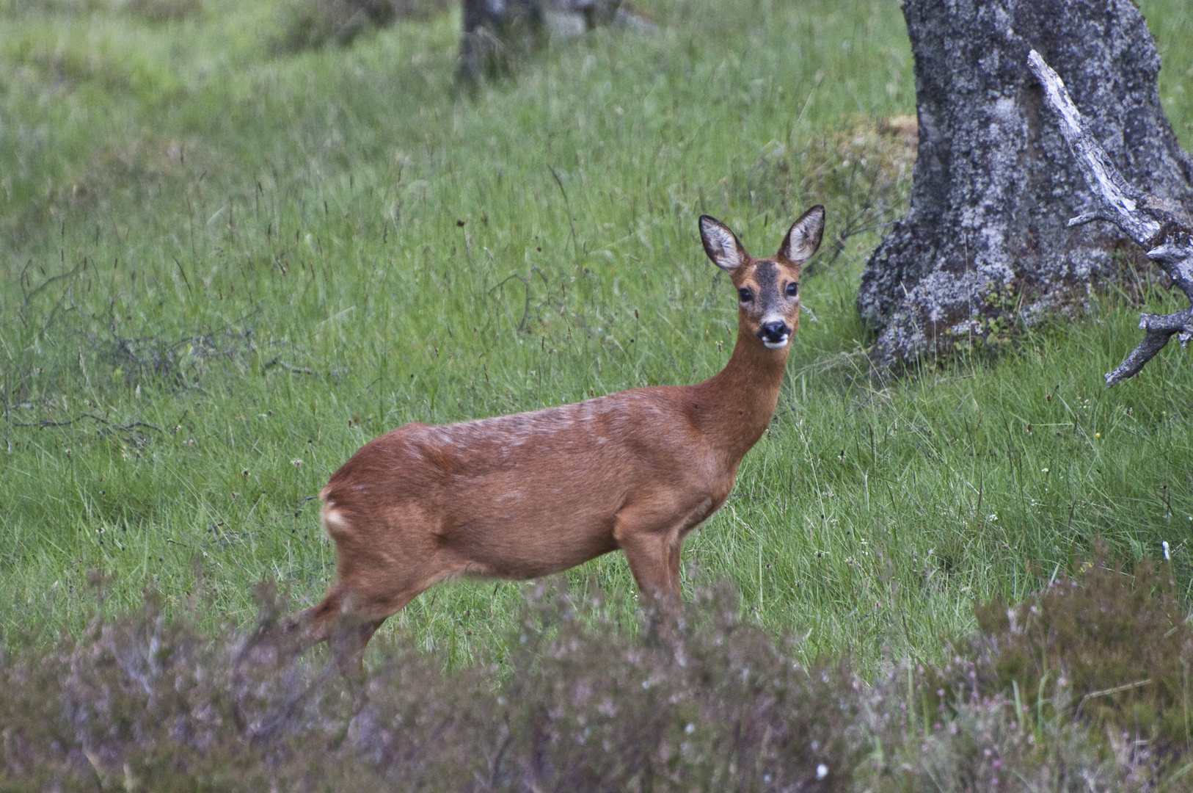
Musk deer
National class I protected animals and now on the verge of extinction.
Notes:
The topic of my presentation today is about the endanger animal musk deer. It is national class I protected animals and now on the verge of extinction.

Slide 2
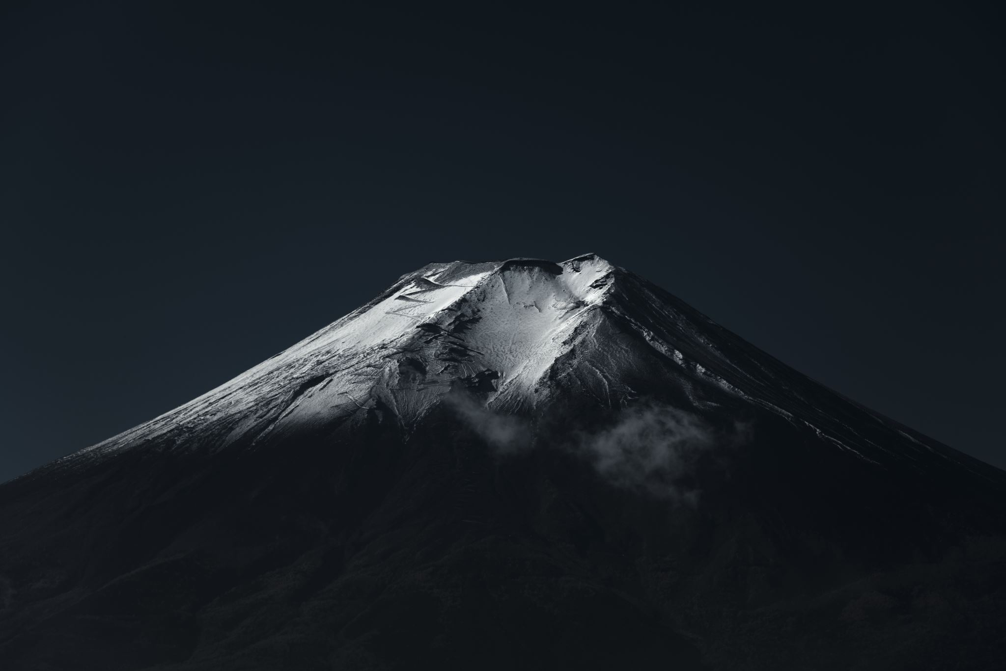
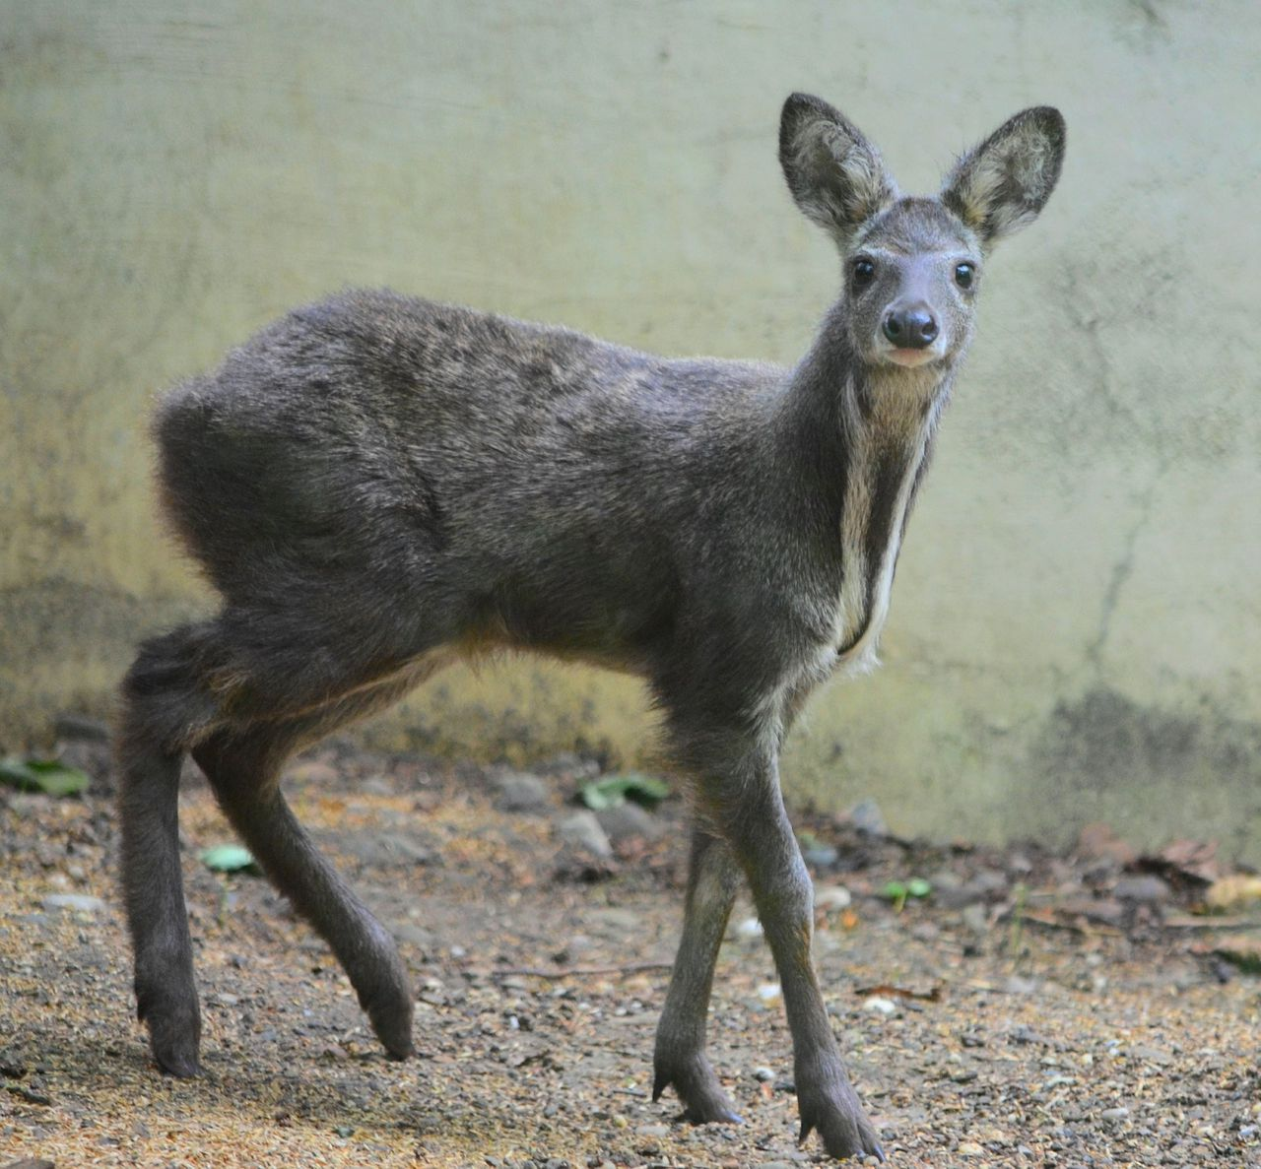
Mammal
Body length about 70cm, shoulder height 47cm.
Weight: about 7kg.
Notes:
First, I will introduce some data. Musk deer belongs to mammals. Their body length are about 70cm, shoulder height are 47cm, and weight are about 7kg.

Slide 3
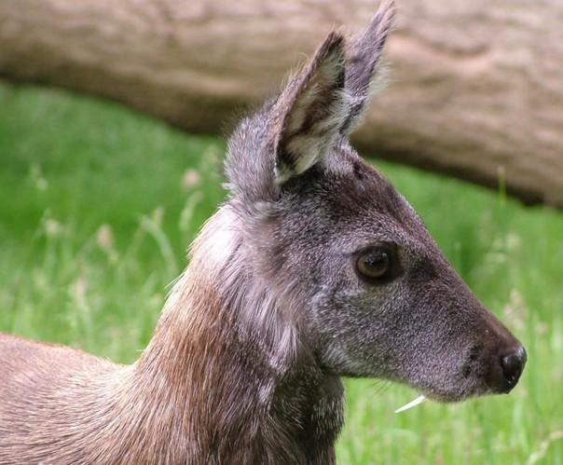
Description
It has no angle, long and upright ears, and the ends are slightly round. The limbs are long and thin, and the hind limbs are longer than the forelimbs. The body hair is thick and hard，olive brown, and the tail is short.
Notes:
Let me describe it. It's a deer, but it's not like a deer. Both male and female have no horns, the ears are long and upright, and the ends are slightly round. The male musk deer has developed canine teeth, long and thin limbs, and the hind limbs are longer than the forelimbs. The body hair is thick, hard, olive brown and the tail is short.

Slide 4
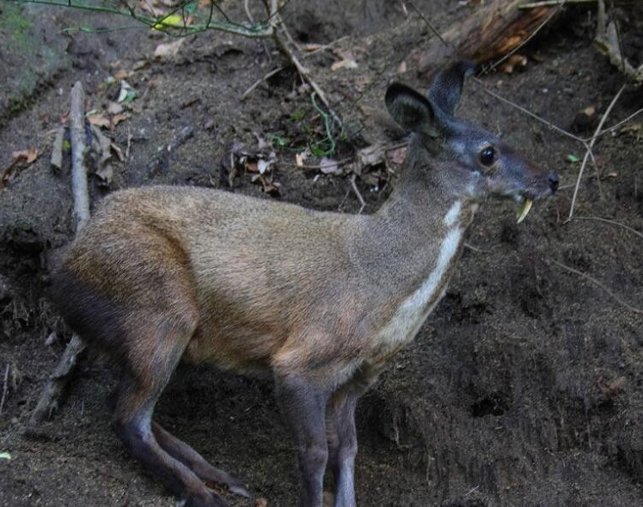
Lifespan: 20 years.
Diet: moss, bamboo, leaf, fern and aromatic leaf.
Notes:
Its life span is about 20 years, generally more than 20 years. It eats moss, bamboo leaf, fern and aromatic leaf shots. So the main thing is the leaves.

Slide 5
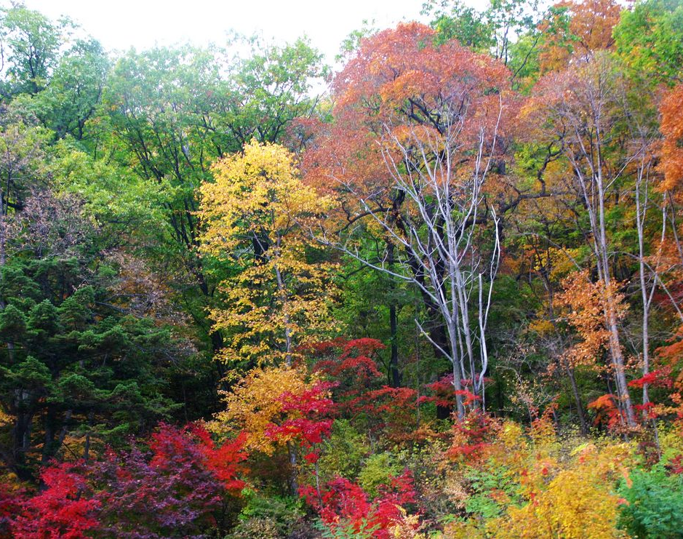
Habitat
Mainly lives in coniferous and broad-leaved mixed forest.
Notes:
Finally, musk deer is a typical mountain animal. It does not inhabit deep mountain forests. So it mainly lives in coniferous and broad-leaved mixed forest, and it is also suitable for living in coniferous forest and broad-leaved forest with poor canopy density. The habitat height can reach 2000 ~ 3800m, but it can survive in low altitude environment.

Slide 6
Reference
Source www.niubeiliang.com/cultural_show.aspx?id=2160
P1: https://tse1-mm.cn.bing.net/th/id/R-C.6d4d92d8415832c7633e0eb450167b60?rik=0RO53wtxzy5tvQ&riu=http%3a%2f%2fimg.fotocommunity.com%2freh-im-wald-bei-braemar-0d7fffe0-781c-4e0f-a8c4-e87f67e6d281.jpg%3fheight%3d1080&ehk=J%2b85%2f2gmgPrAdvMMABgngnM8aVtxvwq7tmnNzSd%2fmsk%3d&risl=&pid=ImgRaw&r=0
P2: https://www.cleveland.com/resizer/5v3FZsQAQ1zLXstwoPyL8zURGrk=/1280x0/smart/advancelocal-adapter-image-uploads.s3.amazonaws.com/image.cleveland.com/home/cleve-media/width2048/img/akron/photo/musk-deer-fawnjpg-4de8e08bdea84057.jpg
P3: https://tse1-mm.cn.bing.net/th/id/R-C.e059272681dbf9d5019f7ac7a861f874?rik=rw2wCC4dBjH9rw&riu=http%3a%2f%2fpic.baike.soso.com%2fp%2f20140327%2f20140327100031-1739202832.jpg&ehk=l4NYVag%2bkAQNcRkO2Wmo0V0mmM%2fnOYCLWBCjkLAlv8k%3d&risl=&pid=ImgRaw&r=0
P4: https://p1.ssl.qhmsg.com/t01ea251c787c6b5d91.jpg
P5: https://tse1-mm.cn.bing.net/th/id/R-C.a6e16660054a8d2c69a8fe87a72ff144?rik=J4HOhk8dpPQqwA&riu=http%3a%2f%2fpic1.arkoo.com%2fxingguo%2fpicture%2f41D5A24326B84317.jpg&ehk=IFgSgnPZB7gmQFEBhSrpZIHf9%2fdFYGwBYlpEzk0U1U4%3d&risl=&pid=ImgRaw&r=0
Notes:
This is the source of the information.

Slide 7

Thanks to watch
Notes:
Over the years, some people have hunted musk at will in order to obtain musk, resulting in a significant decline in the number of musks. So I hope people will not destroy other natural creatures for their own interests.

